Slide 1
Bayesian integrated population modeling using JAGS Estimation of survival probabilities using capture-recapture data

Slide 2
Estimation of survival
The principle to estimate survival is fairly easy:
Follow individuals across time
Count individuals at time t (C_{t}) and assess how many of them are still alive after time Δt (L_{t+Δt})
Survival probability is then
But major problem: all individuals that are still alive, but not seen → classified dead
Typically, we do not know L_{t+Δt}, but only p * L_{t+Δt}, where p is the detection probability
Detection can be estimated, if we extend the experiment to at least one further occasion
Thus, collect capture-recapture data (individual capture histories)
Notes:
Knowing survival rates is important for studies in different fields. You know this better than me, and I think that you have decided to join this course because you are aware of this.
The principle is easy: give an example.
Big problem: some individuals are overseen. This results in an underestimation of the survival rate.

Slide 3
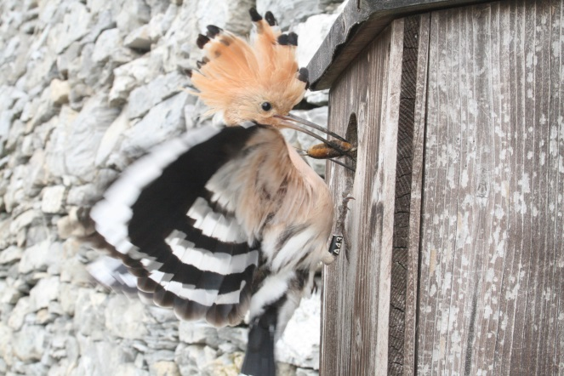
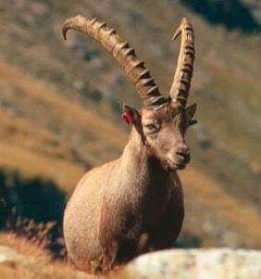
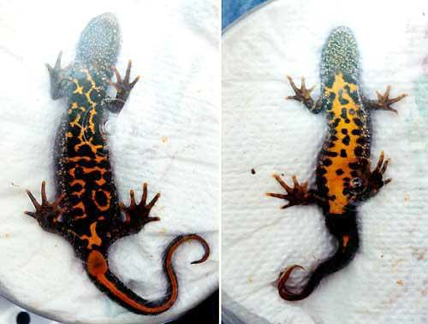
Marking, recaptures and resightings
Artificial marks
Natural marks
… also genetic or acustic recapture

Slide 4
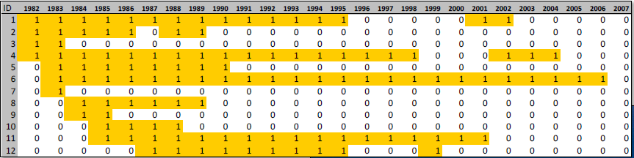
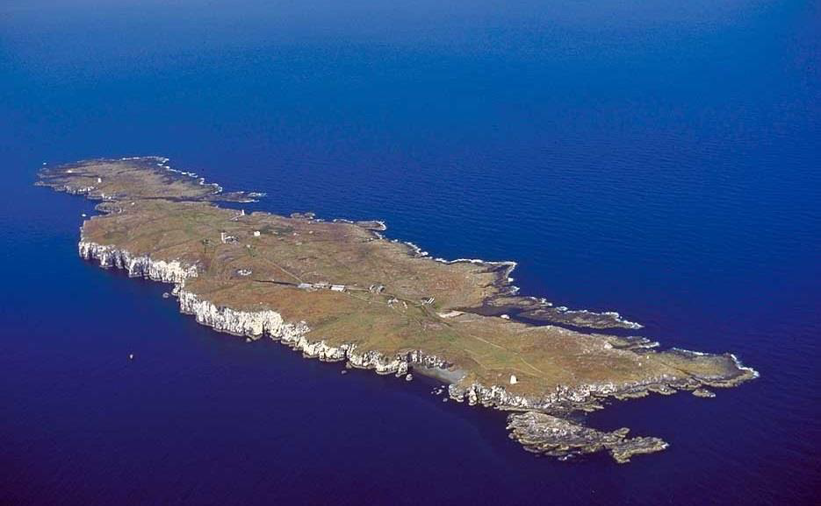
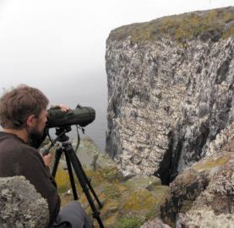
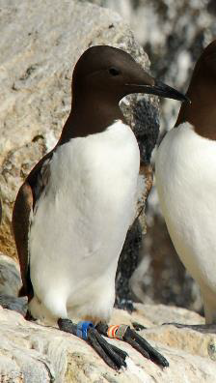
Individual capture history

Slide 5
Individual capture history: result of two processes
State process
Alive
Dead
Seen
Not seen
Observation process
Stochastic process
Deterministic process
Notes:
5
Note that at the occasion of release, there is no recapture possible and the state „alive“ is sure without uncertainty
Individual capture history is 1010000
a key for estimating survival is that we have to follow individuals across time. Thus we have to know and be able to distinguish individuals. This ususally means that we mark individuals with rings, wingmarks or similar – sometimes natural marks or genetic methods can be used.

Slide 6
State-space likelihood to analyse CR data
1. Survival process
where,
z_{i,t}: matrix, indicating whether individual i is alive at time t (z = 1), or dead (z = 0)
φ_{i,t}: apparent survival probability for individual i from time t to t+1
2. Observation process
where,
y_{i,t}: is the observed capture history for individual i at time t
p_{i,t}: recapture probability for individual i at time t

Slide 7
Data
Parameters
Notes:
7

Slide 8
Data
Parameters
Notes:
8

Slide 9
Data
Parameters
Notes:
9

Slide 10
Data
Parameters
Notes:
10

Slide 11
Data
Parameters
Notes:
11

Slide 12
Modelling
along time axis
Time axis:
temporal variation (fixed, random)
temporal covariates
time-constant
Individual axis:
groups (fixed, random)
individual covariates
along individual axis
Interaction of time and individual axes:
age effect (transients)
additive effects (group + time)
cohort effects
trap-response
Same story for detectability
Notes:
12
The modeling is just usualy GLM modelling
write an equation somewhere:
logit(phi [i,t]) = alpha + beta*temp[t]

Slide 13
A simple model: φ(.), p(.)
# Likelihood
for (i in 1:nind){
# Define latent state at first capture
z[i,f[i]] <- 1
for (t in (f[i]+1):n.occasions){
# State process
z[i,t] ~ dbern(phi * z[i,t-1])
# Observation process
y[i,t] ~ dbern(p * z[i,t])
} #t
} #i
phi ~ dunif(0,1) # Prior for survival
p ~ dunif(0,1) # Prior for recapture

Slide 14
Another simple model: φ(t), p(t)
# Likelihood
for (i in 1:nind){
# Define latent state at first capture
z[i,f[i]] <- 1
for (t in (f[i]+1):n.occasions){
# State process
z[i,t] ~ dbern(phi[t-1] * z[i,t-1])
# Observation process
y[i,t] ~ dbern(p[t-1] * z[i,t])
} #t
} #i
phi[t] ~ dunif(0,1) # Prior for survival
p[t] ~ dunif(0,1) # Prior for recapture

Slide 15
A general program structure
# Likelihood
for (i in 1:nind){
# Define latent state at first capture
z[i,f[i]] <- 1
for (t in (f[i]+1):n.occasions){
# State process
z[i,t] ~ dbern(phi[i,t-1] * z[i,t-1])
# Observation process
y[i,t] ~ dbern(p[i,t-1] * z[i,t])
} #t
} #i

Slide 16
A general program structure
# Likelihood
for (i in 1:nind){
# Define latent state at first capture
z[i,f[i]] <- 1
for (t in (f[i]+1):n.occasions){
# State process
z[i,t] ~ dbern(phi[i,t-1] * z[i,t-1])
# Observation process
y[i,t] ~ dbern(p[i,t-1] * z[i,t])
} #t
} #i
Example for φ(.), p(.):
# Priors and constraints
for (i in 1:nind){
for (t in 1:(n.occasions-1)){
phi[i,t] <- mean.phi
p[i,t] <- mean.p
} #t
} #i
mean.phi ~ dunif(0,1) # Prior mean surv
mean.p ~ dunif(0,1) # Prior mean recap

Slide 17
Definition of „survival“
Survival refers to the study area: mortality and permanent emigration are confounded. Therefore we estimate apparent survival, but not true survival.
Assumptions
Design:
No mark lost
Identity of individuals recorded without error (no false positives)
Captured individuals are a random sample
Model:
Homeogeneity of survival and recapture probabilities
Independence between individuals

Slide 18
Parameter identifiability
Intrinsic non-identifiability
Likelihood can be expressed by a smaller number of parameters
Feature of the model
Extrinsic non-identifiability
Model structure is OK, but due to lacking data a parameter cannot be estimated
Feature of the data

Slide 19
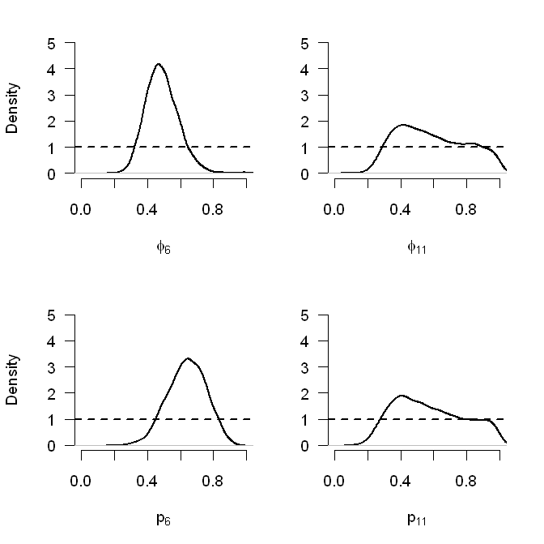
Parameter identifiability
Slightly different in Bayesian
Due to prior knowledge, all parameters are defined, but they may not be informed by the data
Compare prior and posterior
Example: classic CJS (φ_{t}, p_{t}) with 12 years and uniform priors

Slide 20
Multinomial model for capture-recapture data
From the capture-histories to the m-array data format
Capture histories
1 0 1 0
1 1 0 0
1 0 1 1
0 1 0 0
m-array
Recapture occ.
Release occ. 2 3 4 Never recaptured
1
2 -
3 - -

Slide 21
Multinomial model for capture-recapture data
From the capture-histories to the m-array data format
Capture histories
1 0 1 0
1 1 0 0
1 0 1 1
0 1 0 0
m-array
Recapture occ.
Release occ. 2 3 4 Never recaptured
1 1
2 -
3 - - 1

Slide 22
Multinomial model for capture-recapture data
From the capture-histories to the m-array data format
Capture histories
1 0 1 0
1 1 0 0
1 0 1 1
0 1 0 0
m-array
Recapture occ.
Release occ. 2 3 4 Never recaptured
1 1 1
2 - 1
3 - - 1

Slide 23
Multinomial model for capture-recapture data
From the capture-histories to the m-array data format
Capture histories
1 0 1 0
1 1 0 0
1 0 1 1
0 1 0 0
m-array
Recapture occ.
Release occ. 2 3 4 Never recaptured
1 1 1+1
2 - 1
3 - - 1 1

Slide 24
Multinomial model for capture-recapture data
From the capture-histories to the m-array data format
Capture histories
1 0 1 0
1 1 0 0
1 0 1 1
0 1 0 0
m-array
Recapture occ.
Release occ. 2 3 4 Never recaptured
1 1 1+1
2 - 1+1
3 - - 1 1

Slide 25
Multinomial model for capture-recapture data
From the capture-histories to the m-array data format
Capture histories
1 0 1 0
1 1 0 0
1 0 1 1
0 1 0 0
m-array
Recapture occ.
Release occ. 2 3 4 Never recaptured
1 1 2 0 0
2 - 0 0 2
3 - - 1 1

Slide 26
Multinomial model for capture-recapture data
Cell probabilities of the m-array:
Recapture occ.
Rel. 2 3 4 Never
φ₁p₁ φ₁(1-p₁)φ₂p₂ φ₁(1-p₁)φ₂(1-p₂)φ₃p₃ 1-Σ₁
- φ₂p₂ φ₂(1-p₂)φ₃p₃ 1-Σ₂
3 - - φ₃p₃ 1-Σ₃
Likelihood of the m-array:
where
m_{t} = t^{th} row of m-array
q_{t} = cell probabilities of the m-array for release occasion t
R_{t} = number of released individuals at occasion t

Slide 27
Bayesian GOF: Posterior predictive check (PPC)
Several Bayesian GOF are possible (reviewed by Conn et al. 2018)
Here we use a general and very common Bayesian model-checking procedure, the posterior predictive check
In a nutshell:
Quantify how different the observed data is compared to what we expect from the estimated parameters [measure of discrepancy]
To assess how “bad” or “good” that difference is, compare to the same measure of discrepancy obtained for ideal data simulated from the estimated parameters
This double comparison is done for each sample of the MCMC chains
Generally straightforward to implement in BUGS or in R after the analysis (from the MCMC chains)

Slide 28
Bayesian GOF: Posterior predictive check (PPC)
Basic algorithm:
At each MCMC iteration 𝑡:
Calculate a discrepancy statistic 𝐷(𝑥;𝑒_{𝑡}) to measure some “distance” between the observed data 𝒙 and the corresponding expected values, 𝑒_{𝑡} at that iteration (based on the MCMC chain values of the parameters)
Generate a new data set 𝑥_{𝑡} from the fitted model (using the MCMC chain value of the parameters)
Calculate a discrepancy statistic 𝐷(𝑥_{𝑡};𝑒_{𝑡}) to measure the “distance” between the simulated data 𝒙_{𝒕} and the corresponding expected values, 𝑒_{𝑡} at that iteration

Slide 29
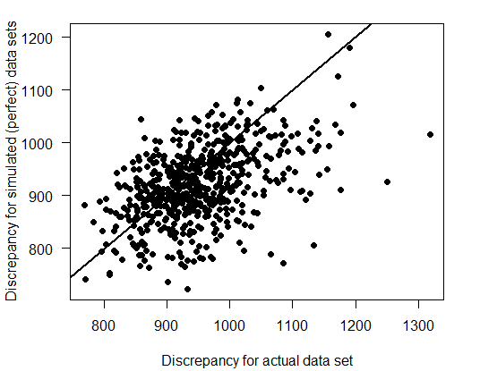
Bayesian GOF: Posterior predictive check (PPC)
Then, use the values of 𝐷(𝑥; 𝑒_{𝑡}) and 𝐷(𝑥_{𝑡}; 𝑒_{𝑡}) to check the fit…
1) ...graphically: scatterplot of 𝐷(𝑥; 𝑒_{𝑡}) and 𝐷(𝑥_{𝑡}; 𝑒_{𝑡})
No evidence of lack of fit if ~½ points above and
~½ below a 1:1 line
2) …numerically by calculating a Bayesian p-value = proportion of times that 𝐷(𝑥; 𝑒_{𝑡}) < 𝐷(𝑥_{𝑡}; 𝑒_{𝑡})
→ close to 0.5: good fit
→ close to 0 or 1: suggests doubtful fit

Slide 30
Bayesian GOF: Posterior predictive check (PPC)
On what response to define observed and expected values?
• Not on binary responses (i.e. detection histories) themselves
• Use some aggregating: m-array in CR data
What measure of discrepancy?
• Different options, e.g.
– Pearson chi-squared statistic
– Freeman-Tukey statistic
• Different measures sensible to different kinds of lack of fit; resulting P-values may differ substantially
• Normally assess some global measure of lack of fit; can also assess particular features of the model (e.g. extreme values)

Slide 31
Bayesian GOF: Posterior predictive check (PPC)
Implicitly depend on priors
Bayesian P-values have been criticised
They use data twice:
simulate data; compare them to these data
Not clear what values represent a good fit
→ Descriptive only! (not for model selection)

Slide 32
Jolly-Seber model
The CJS model is conditional on first capture
0 0 0 1 0 1 0 0 0

Slide 33
Jolly-Seber model
The CJS model is conditional on first capture
conditional
0 0 0 1 0 1 0 0 0

Slide 34
Jolly-Seber model
The CJS model is conditional on first capture
The Jolly-Seber model is unconditional
Estimation of recruitment and population size is possible
Requires an additional assumption (capture = recapture)
See chapter 10 in BPA book
conditional
0 0 0 1 0 1 0 0 0
unconditional

